Slide 1
Developing Great Physician and Administrative Leaders
David Hefner
Senior Advisor, AAMC
Kathi Becker
Managing Partner, PLB Ventures
and TM-LD Team, AAMC

Slide 2
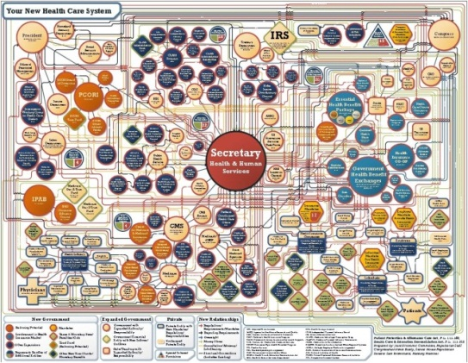
Why This, Why Now?
“We need a very different way of working… an action agenda of coordinated change unlike anything we ever have experienced in academic medicine.”
Darrell Kirch, President AAMC
2010 AAMC Annual Meeting
“Healthcare leaders today are faced with adaptive challenges, which in contrast to technical problems, are complex problems for which they have little or no preexisting experience or solutions.”
Wiley S. Souba, Dean
Dartmouth Medical School

Slide 3
What today is about
This will be an interactive session
3
The Foundations of Great Leadership
Notes:
3

Slide 4
Why you?
Where would you like to be more effective as a leader?
What would be different if that happened?
Notes:
© 2008 Sunergos LLC. All rights reserved.
4

Slide 5
What in the World are You Listening To?
Foreground Conversation
  What is said
Background Conversation
  What is ‘unsaid’, thoughts
  Conversation with yourself, ongoing internal dialogue
Unsaid
“What’s the point?”
Said
“ What should I
have for dinner?”
“This slide is messy, hope they get better”
“Its cold here”
“I thought she said
this would be useful”
Which conversation are you listening to most of the time?

Slide 6
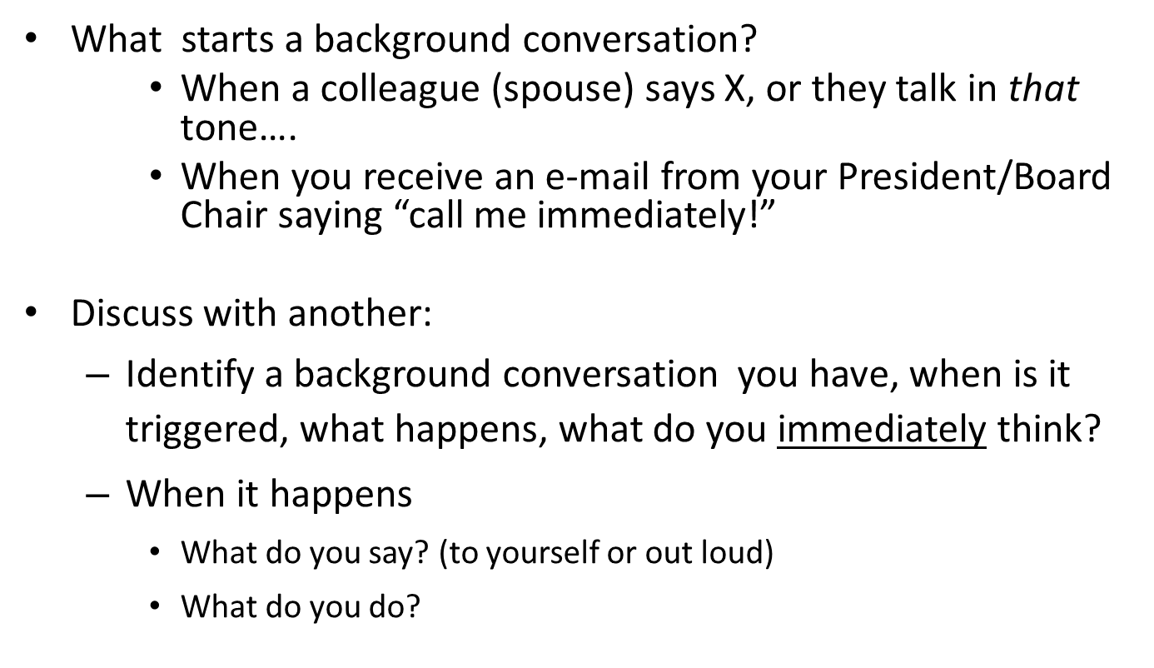
Exercise
Notes:
© 2008 Sunergos LLC. All rights reserved.
6

Slide 7
Two Ways We Can Listen
Stingy
Closed, not interested
Bored
A lot on your mind
Distracted
Really busy
Reading the blackberry
Generous
Open, available
Interested, curious
Tuned in, following
Listening to learn
Engaged
Generous listening can leave people the experience of
being appreciated and respected
PLB Ventures
Proprietary & Confidential

Slide 8
TIPS !!
Practices to Enhance Listening
What you can do about it
  Ask if the other person has time to talk (and listen)
  When asked, if you are too busy or too full to listen, say so.
  Be honest, admit when you have checked out or weren’t listening
  Ask for more grounding in the discussion, especially when you don’t understand what is being said.
  Say what you think is being said, to see if you are on track (or lost)
  Don’t wait until after the meeting to find out what was going on in it, ask in the meeting.
  Let people know when you really need their full attention, and what you will need from them in the end.
  Stop talking from time to time and give people a chance to talk to each other, then ask questions after that.
What else?

Slide 9
What Do These Say?
BIRD
IN THE
THE HAND
XX
PARIS
IN THE
THE SPRING
XXX
What we know already can prevent us from
seeing what is actually there
Notes:
© 2008 Sunergos LLC. All rights reserved.
9

Slide 10
Listening
People usually think effective speaking is the access to successful communication.
We ask you to consider the perspective that ‘listening grants speaking’.
If you alter your listening and listen generously for what your audience might be thinking, you will dramatically improve the quality of communication in your organization.

Slide 11
Being a Great Leader
Listening generously

Slide 12

Integrity
Definition: Webster’s New World Dictionary.
  The quality or state of being complete; unbroken condition; wholeness; entirety
  The quality or state of being unimpaired; perfect condition; soundness
  The quality or state of being of sound moral principle; uprightness, honesty, and sincerity
When the 3rd definition is added, a Gordian Knot is created
12

Slide 13
The Knot, or Not?
Untying the knot requires separating integrity from the normative, agreed upon realms of morality, ethics and legality.
  Morality
    Arises from societal considerations outside of you
    Can be applied to person, group, or entity
  Ethics
    Apply within a given group (subcategory of a given society)
    May include basis for discipline and/or exclusion
  Legality
    System of evolving laws and regulations
    Enforceable through policing/judicial process
13

Slide 14
The Law of Integrity: A Heuristic
TIP !!
The Law of Integrity states:
  As integrity (whole and complete) declines, workability declines, and as workability declines, the opportunity for performance declines.
  Thus, to produce the maximization of whatever performance measure you choose requires integrity.
If you operate in life as though this heuristic is true, performance will increase dramatically.
The impact on org performance can range from 100% to 500%.
14

Slide 15
Integrity and Performance
Starting with objects:
An object has integrity when it is whole and complete
      What happens if a bicycle wheel has missing spokes?
      To your car if you don’t change the oil?
15

Slide 16
What is Integrity For A Person?
Integrity for a Person:
Is a Matter of That Person’s Word, Nothing More and Nothing Less
  For a person to have integrity, his or her word is whole and complete
  What does that mean?
16

Slide 17
What is Your Word?
1. What You Said
2. What You Know
3. What Is Expected
4. What You Assert Is So
5. What You Say You Stand For
6. Moral, Ethical And Legal Standards
17
Notes:
.

Slide 18
What is ‘Out-Of-Integrity’ Behavior
Examples include:
Making commitments we don’t keep, late or non-delivery with no
communication
Showing up late and/or not prepared for meetings, or don’t show up at all,
Secretly reading documents, answering emails, or working on other matters
while in meetings,
Failing to return telephone calls when promised,
Violating or playing games with negotiated agreements or organizational
policies
Lying to others including our spouses, children, friends, co-workers (including
not being straight when it is merely uncomfortable to do so),
Cheating on taxes,
Stealing (e.g., keeping excess change when mistakenly given or padding
expense reports),
Using the web for personal reasons at work, including shopping on line…
Now what’s background conversation saying?
Notes:
© 2008 Sunergos LLC. All rights reserved.
18

Slide 19
What is Meant by Honoring Your Word?
Keeping your word
  OR:
Whenever you will not keep your word as soon as you become aware that you will not be keeping your word (including not keeping your word on time) saying to everyone who will or may be impacted:
  That you will not be keeping your word, and
  That you will keep that word in the future and by
  when, or that you won’t be keeping your word, and
  What you will do to deal with the impact on others of the
  failure to keep your word (or not to keep it on time).

Slide 20
Honoring Your Word Builds Trust
When the literature on trust talks about “walking the talk”, it says that to be trusted you must keep your word.
Surprising to many is the fact that you will engender a greater degree of trust (and admiration) when you do not keep your word, but you do honor your word.
Honoring your word when you have not kept it starts with being open/honest about the fact that you gave your word, and you did not keep it.
This is sufficiently uncommon that often this alone cleans up the mess you caused and therefore may be enough to maintain your integrity.
20

Slide 21
Integrity Is The Pathway to Trust
Trust is not something you can do.
  Trust grows as a result of the actions you take when honoring your word.
  Is not the same as likeability or sincerity – we all know people who we like, but we do not trust.
  When you honor your word, trust becomes almost instantly available.

Slide 22
Being a Great Leader
Listening generously
Operating with integrity

Slide 23
Authenticity
Definition: The Random House Dictionary, 2011.
The quality of being authentic; genuineness.
Authenticity is being and acting consistently with who you hold yourself out to be for others and for yourself. (You seem authentic when who you say you are and how you act are the same, all the time.)
Being authentic leaves you grounded, straight with yourself and others, and gives you power to lead without needing force.
Without authenticity you can forget about being a great leader.

Slide 24
Being Authentic
After 40 years of studying human beings, on the subject of our inauthenticity Chris Argris says:
“Put simply, people consistently act inconsistently, unaware of the contradiction between their espoused theory and their theory-in-use, between the way they think they are acting, and the way they really act.”
        Chris Argyris
        Harvard Business Review, “Teaching Smart People
        How to Learn” (1991, pp. 99-109)
24

Slide 25
Examples Of Inauthenticity
We all want to be admired, and almost none of us confronts how much we want to be admired and how readily we might not be straightforward or completely honest in a situation where we perceive doing so threatens a loss of admiration.
In addition, most of us have a need for being seen by others as ‘good’ and we don’t confront just how much we care about looking good to others.
  We may pretend to have followed or understood something being
  Said, when we haven’t.
  We don’t ask a question because we worry it could sound stupid.
  While this may sound like a description of this or that person you
  know, it actually describes each person
The actionable access to authenticity is being authentic about your inauthenticity.
Notes:
© 2008 Sunergos LLC. All rights reserved.
25

Slide 26
Being Authentic about Inauthenticity
Most of us think of ourselves as being authentic; however, each of us in certain situations, or in certain ways, is consistently inauthentic.
Often we avoid at all costs confronting our inauthenticity, and are therefore consistently inauthentic about being inauthentic – not only with others, but with ourselves.
To be a great leader one must find the courage to be honest about one’s inauthenticity (at least with oneself)
Our inauthenticity may be hidden from our view, they can live in our mental blind spots, but rarely is it hidden from others’. See Van Hecke (2007)
26

Slide 27
Authenticity
Great leaders are noteworthy in having come to grips with these foibles.
  Not eliminating them, recognizing they have them and
  Moving beyond these concerns when they come up.

Slide 28
Being a Great Leader
Listening generously
Operating with integrity
Being authentic (including about your inauthenticity)

Slide 29

What do you get paid for?
Every Organization has a Drift:
It’s the way things have always gone – like being carried by a current
Propensity to continue on (in the same direction)
It provides the predictable way things turn out
“Going with the flow”
Your job (we assert) is to intervene in the drift and make something happen that matters, that wouldn’t happen otherwise. Something that is bigger than yourself.
Isn’t that really why they pay you?
Notes:
© 2008 Sunergos LLC. All rights reserved.
29

Slide 30
Committed To Something
Bigger Than Oneself
What we mean by “committed to something bigger than oneself” is being committed such that who you are being and your actions are in service of realizing something beyond one’s personal concerns for oneself.
As they are acted on, such commitments create something to which others can also be committed, and have a sense that their lives are about something bigger than themselves.
    When people are operating inside these commitments, their tolerance for ambiguity increases, and
    Their passion, energy and creativity are also enhanced.
30

Slide 31
“This is the true joy in life, the being used for a purpose recognized by yourself as a mighty one; the being a force of nature instead of a feverish selfish little clod of ailments and grievances complaining that the world will not devote itself to making you happy.
I am of the opinion that my life belongs to the whole community, and as long as I live, it is my privilege to do for it whatever I can.
I want to be thoroughly used up when I die, for the harder I work the more I live. I rejoice in life for its own sake. Life is no “brief candle” to me. It is a sort of splendid torch which I have got hold of for the moment, and I want to make it burn as brightly as possible before handing it on to future generations.”
        George Bernard Shaw
        Man and Superman

Slide 32
Are Great Leaders Extraordinary People?
We recognize great leaders after they have gotten there. And, after they have gotten there they appear to be extraordinary people.
However, when the whole story is told, every great leader was an ordinary person who was given being and action by something bigger than themselves.
To assume that great leaders started out extraordinary is to demean what it took for them to go beyond “who they wound up being”.
More importantly, it can conceal your access to being an extraordinary leader.
32

Slide 33
Valley Of The Shadow Of Death
By the way, on their way to greatness, every great leader faces times of being so massively thwarted that they are left with a sense of hopelessness – a profound sense that they are inadequate for the task at hand.
At these times, the world occurs as immovable, impossible, and they are left with nothing to give, nothing to draw on. No help, no way.
In these “valley of the shadow of death” times (when giving up or quitting seems to be the only viable option), in order to generate the being and action required to get yourself through these tough times, you will need to have in place something bigger than yourself and your circumstances.
33

Slide 34
The Outcome of Great Leadership
The realization of a future that wasn’t going to happen anyway, that fulfills (or contributes to fulfilling) the fundamental concerns of the relevant parties.

Slide 35
Being a Great Leader
Listening generously
Operating with integrity
Being authentic (including about your inauthenticity)
Committing to something bigger than oneself

Slide 36
The Source Of Action:
Why People Do What They Do
Reliably
Correlated
How the world
Occurs for them
ACTION
RESULTS
Notes:
© 2008 Sunergos LLC. All rights reserved.
36

Slide 37
Playing the Violin in a Subway
Dressed in jeans and a baseball cap, a 39 year-old ‘fiddler’ stood against a wall next to a trash can at the L’Enfant Plaza metro station in Washington D.C. He looked like any other street musician trying to make a buck. During the 43 minutes that he played his violin, researchers watched 1,097 people pass by during the morning rush hour. It took 3 minutes before someone even gazed in his direction, and even longer before any money was thrown into his violin case.
Most people did not notice the musician. Some were talking
on cell phones, others listened to iPods. Masterful pieces such as Bach’s “Chaconne”, Franz Schubert’s “Ave Maria”, and Manuel Ponce’s “Estrellita”, were passed off as nothing more than “generic classical music”. (Weingarten, 2007)
That day, the fiddler made $32.17, or 75 cents a minute.

Slide 38
Playing the Violin in a Subway
When situated within an upscale concert hall dressed in black, the same 39 year-old ‘fiddler’, Joshua Bell, on the same $3.5 million Stradivari violin, commands up to $1,000 a minute playing the exact same masterpieces. This elite musician is said to be “one of the finest classical musicians in the world, playing some of the most elegant music ever written on one of the most valuable violins ever made.” (Weingarten, 2007)
Within the context of a subway street musician, a measly seven people were moved to stop and listen before walking by. Within the context of a famous concert hall musician, thousands of listeners invest significant money to hear and be moved by Bell’s music, often with standing room only.
The context uses you in that it shapes your way of being, which includes your perceptions, imagination, emotions, and thinking, and as a consequence the context shapes your actions.

Slide 39
The Power of Context
  Physician
  Administrator
__________________________
Context is decisive
Context uses you: it shapes your way of being, which includes your perceptions, imagination, emotions, and thinking, and your actions.

Slide 40
The Power of Context
  Already Knowing
  Listening Generously
__________________________
Context is decisive
Great leaders are committed to something beyond the limits of what they already know how to do, their success depends on collaboration with others.

Slide 41
The Power of Context
  Talk is Cheap
  Honoring Your Word
__________________________
Context is decisive
People will only follow a leader they can trust.

Slide 42
The Power of Context
  Predictable Future
  Future as a Bold Possibility
__________________________
Context is decisive
Great Leaders are committed to something bigger than themselves, a future that inspires the relevant parties

Slide 43
Being a Great Leader
“In a real sense all life is inter-related. All men are caught in an inescapable network of mutuality, tied in a single garment of destiny. Whatever affects one directly affects all indirectly....
I can never be what I ought to be until you are what you ought to be, and you can never be what you ought to be until I am what I ought to be.
This is the inter-related structure of reality”
Martin Luther King, Jr.

Slide 44
Outcomes of the session
You will leave with:
An ability to transcend what frequently gets in the way of effective communication.
Clarity about increasing trust and performance.
Understanding the power of context and its relationship to being a great leader.
Thanks for Listening!
Be Great Leaders, the future is up to you.
44
Notes:
44

Slide 45
Parts of this session is derived from the following materials:
“Transformative Learning: Theory to Practice”, by Jack Mezirow New Directions in adult and Continuing Education, Jossey-Bass Publishers
“Integrity: A Positive Model that Incorporates the Normative Phenomena of Morality, Ethics and Legality”, Michael C. Jensen, Werner Erhard and Steve Zaffron, unpublished working paper in process, available at: http://ssrn.com/abstract=920625
“Untying the Gordian Knot” by Keith Devlin Sept 2001 http://www.maa.org/devlin/devlin_9_01.html
“New Paradigm of Leadership” Kari Granger, Werner Erhard, Michael C. Jensen Http://ssrn.com/abstract=920623

